Slide 1
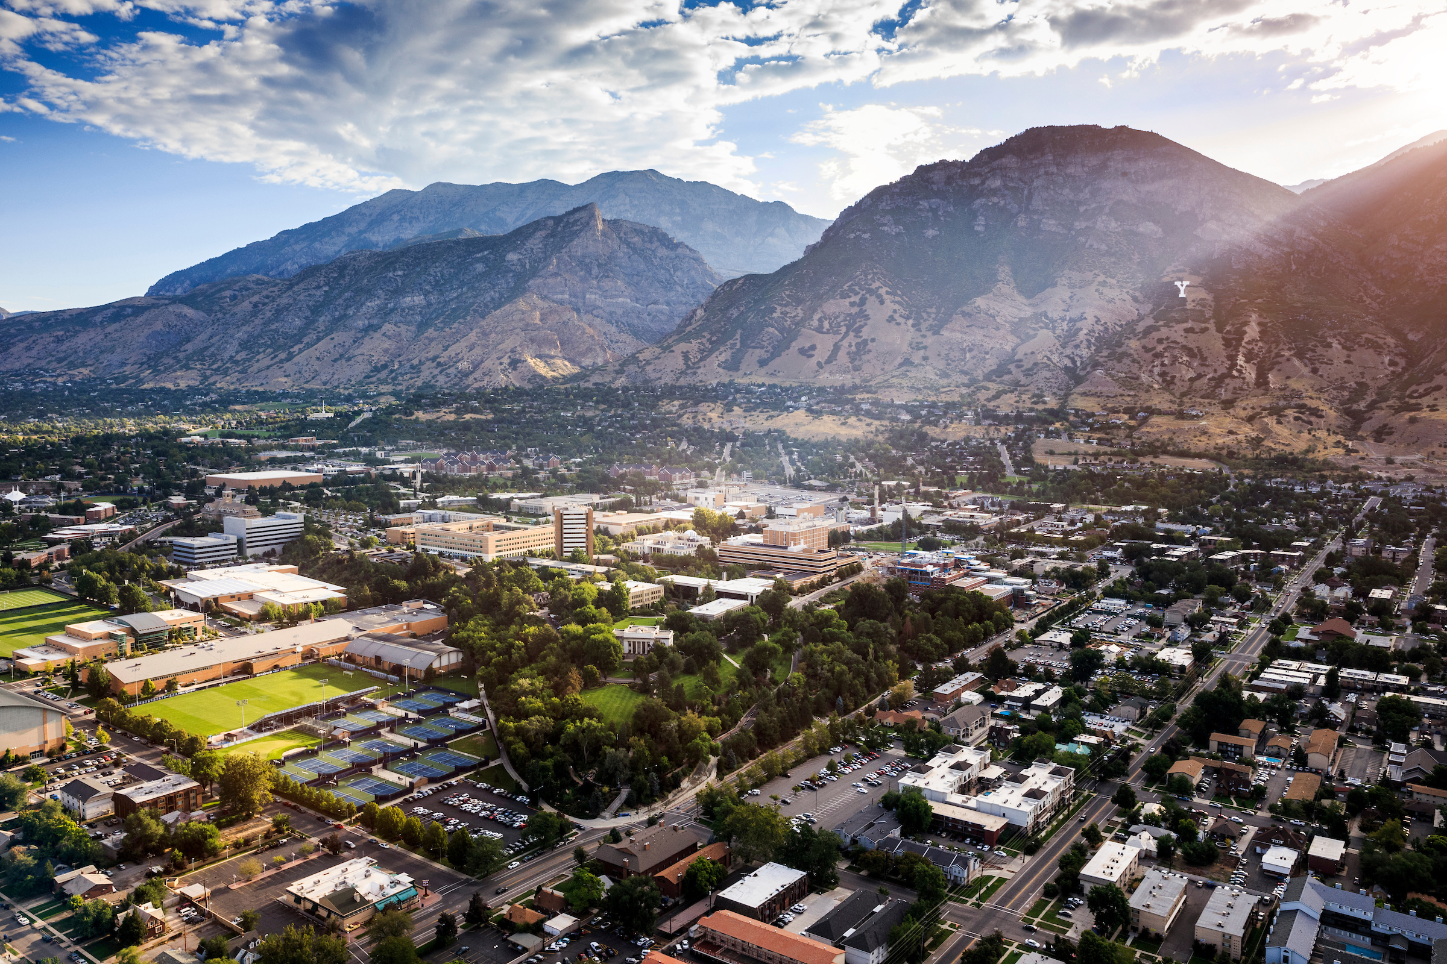

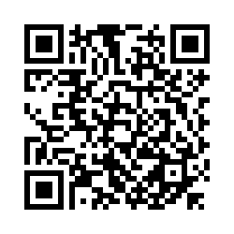
SEXUAL
HARASSMENT
POLICY TRAINING
2021-22

Slide 2
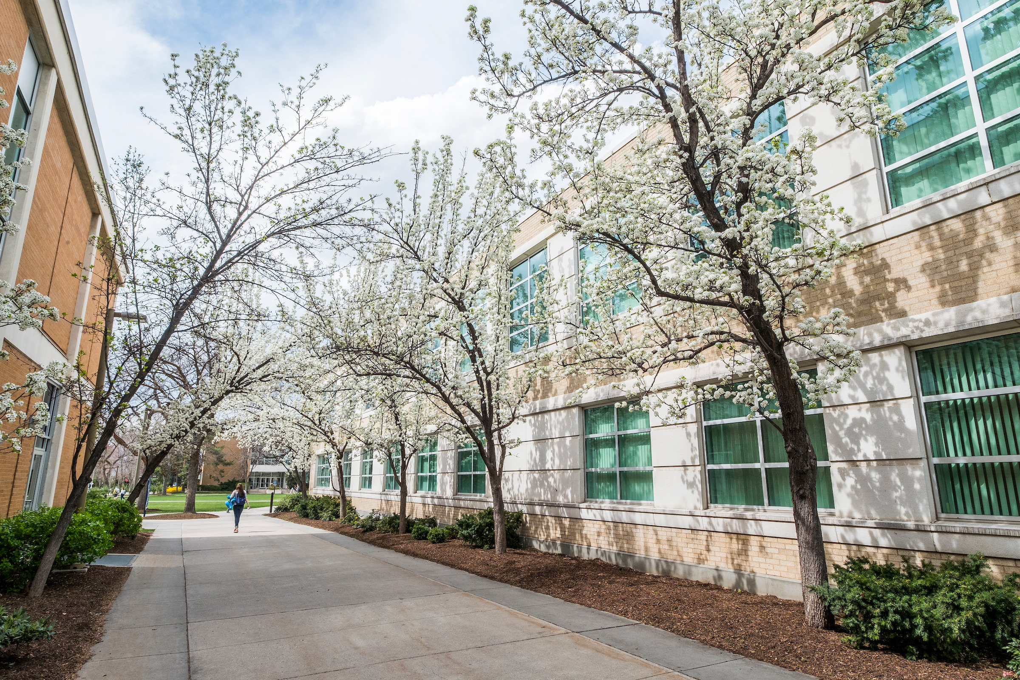
Brigham Young University is committed to promoting and maintaining a safe and respectful environment for the campus community

Slide 3

BYU’S TITLE IX OFFICE
The Title IX Office is dedicated to promoting gender equity by coordinating the university's efforts to prevent and respond to gender discrimination and sexual harassment

Slide 4
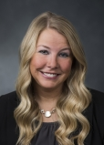
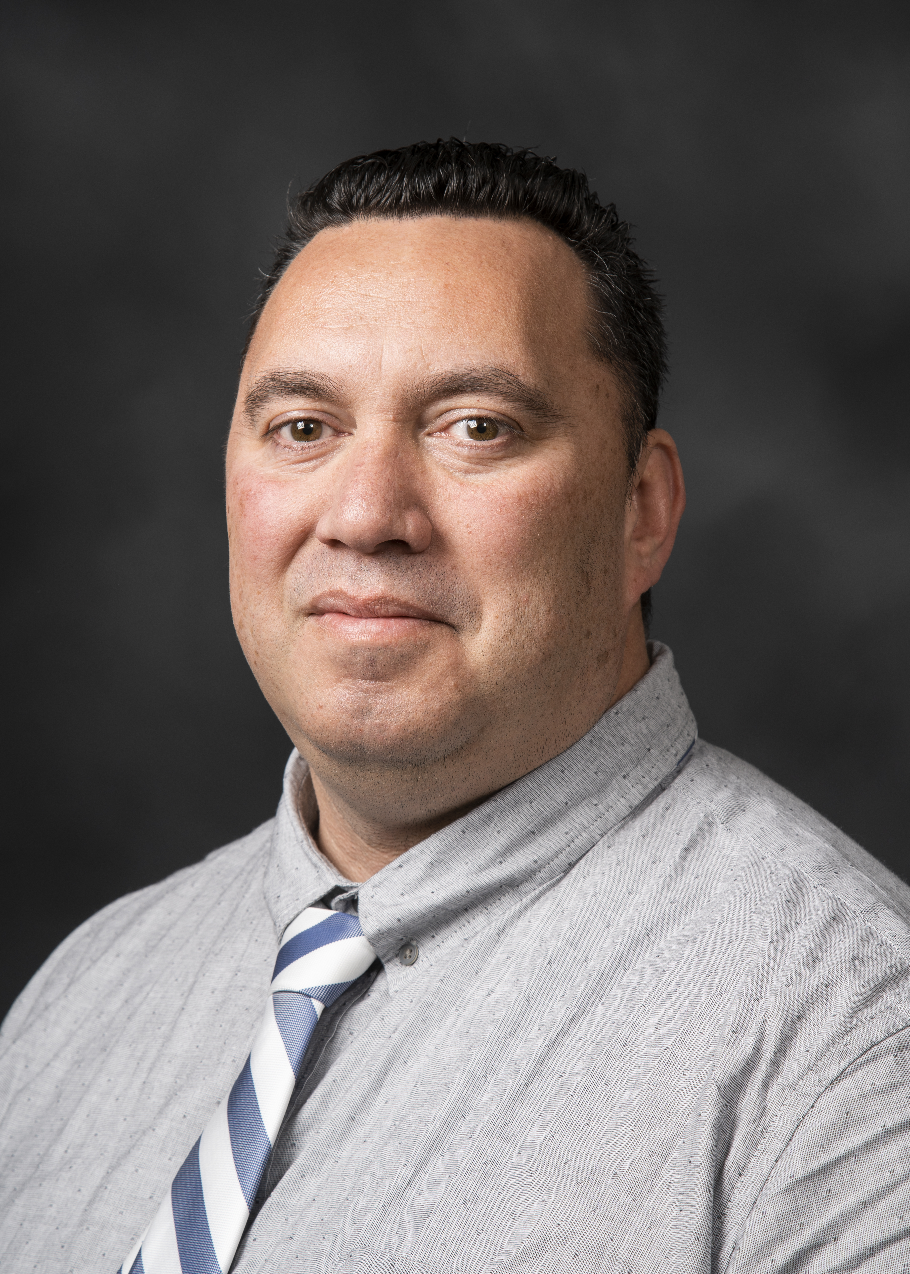
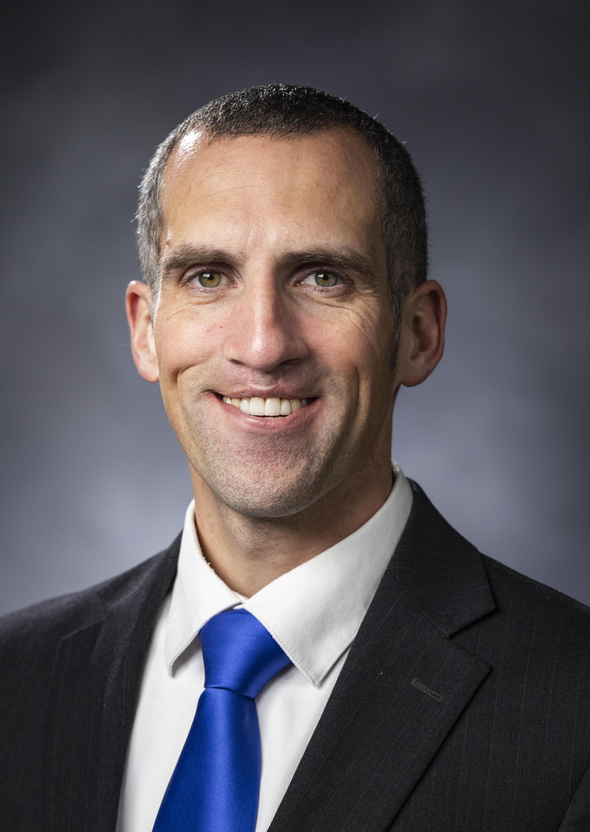
THE TITLE IX TEAM
Tiffany Turley
Title IX Coordinator
Eugene Marshall
Deputy Coordinator
Students
David Rasmussen
Deputy Coordinator
Training & Education
Abigail Morrison
Office Manager
BYU Title IX Office
801-422-8692
1085 WSC
t9coordinator@byu.edu

Slide 5
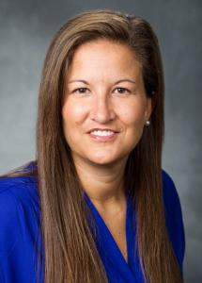
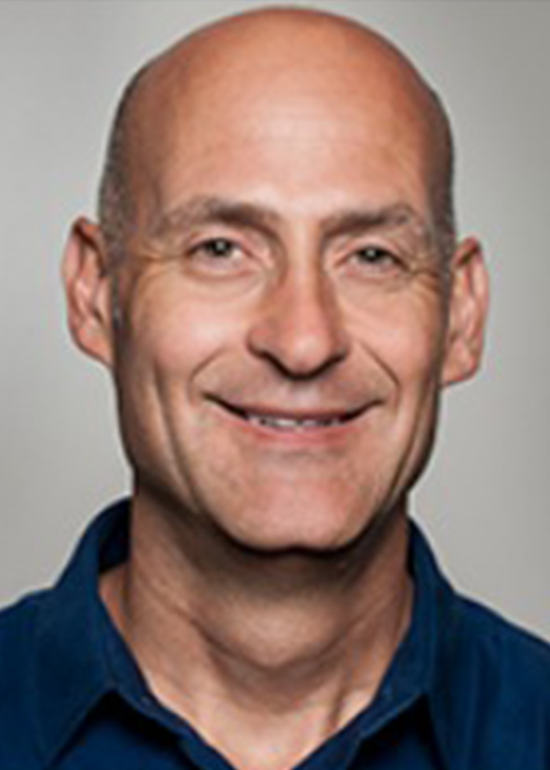
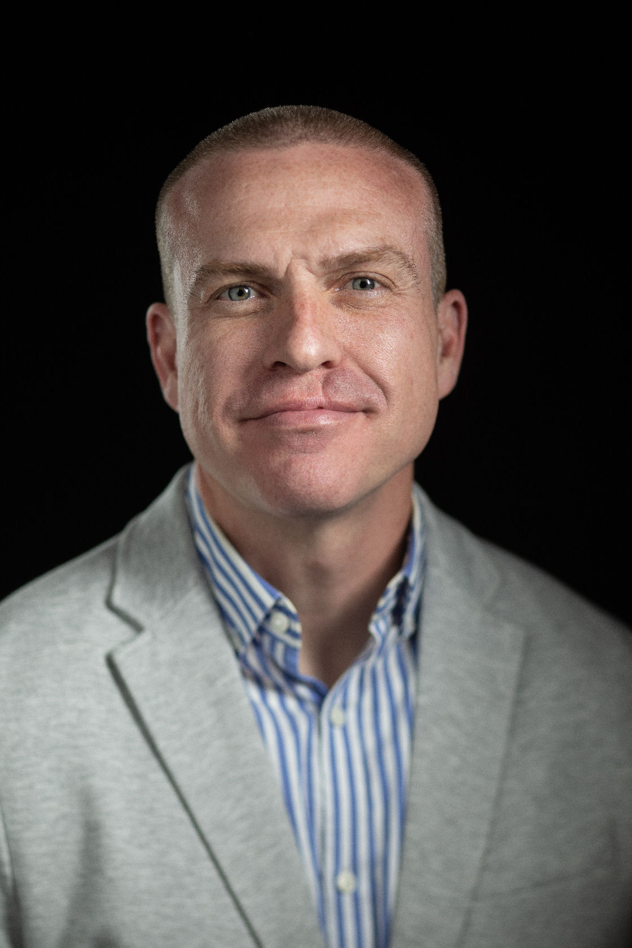
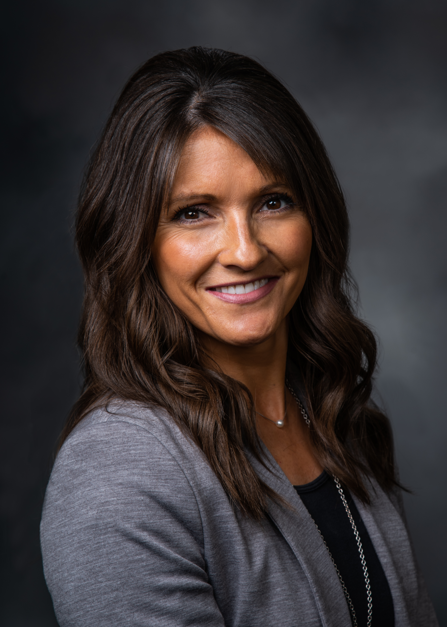
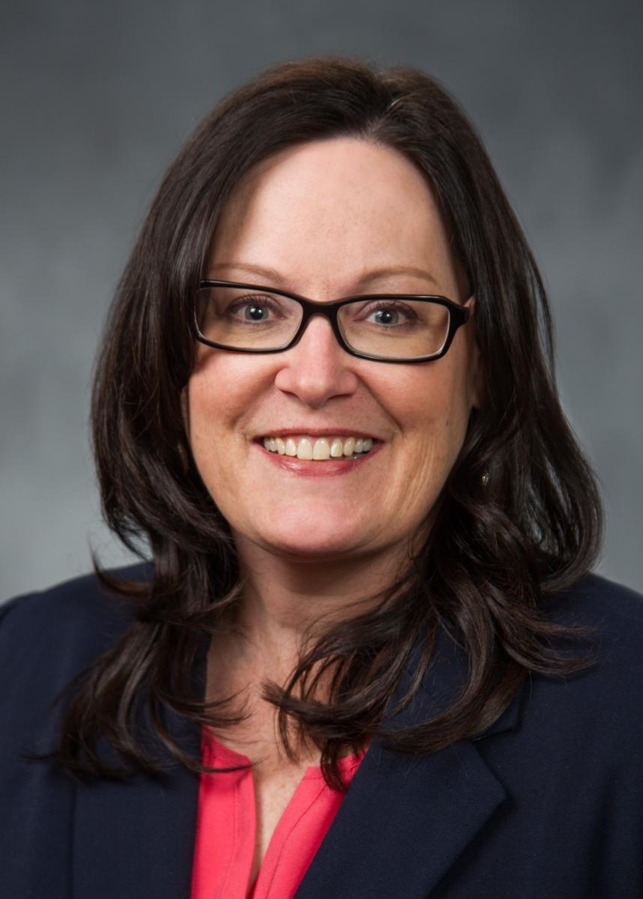
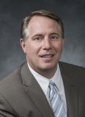
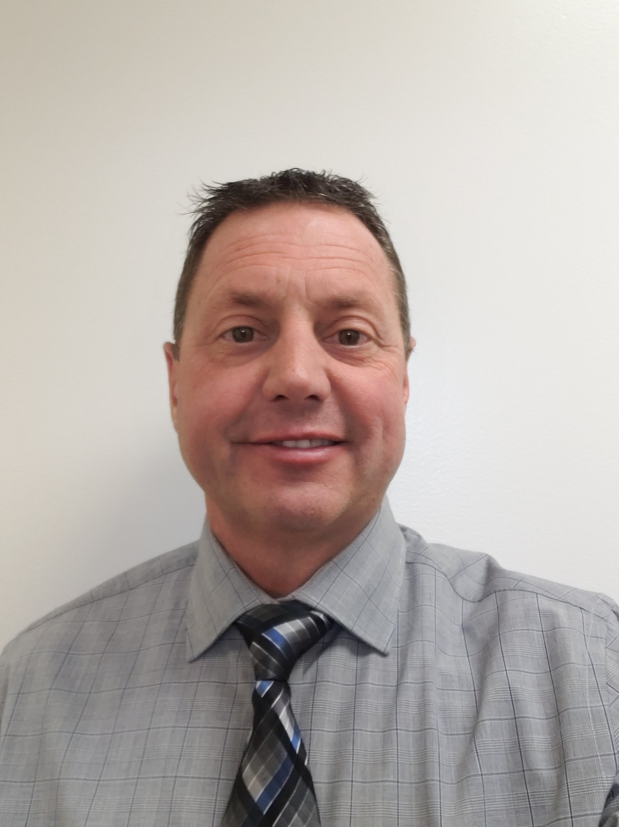
CAMPUS TITLE IX LIAISONS
Liz Darger
Athletics
Landes Holbrook
International
Bryan Hamblin
Law School
Sara Hubbs
Marriott School
Collette Blackwelder
Employees
Tom Patterson
Faculty
Wade Raab
University Police

Slide 6

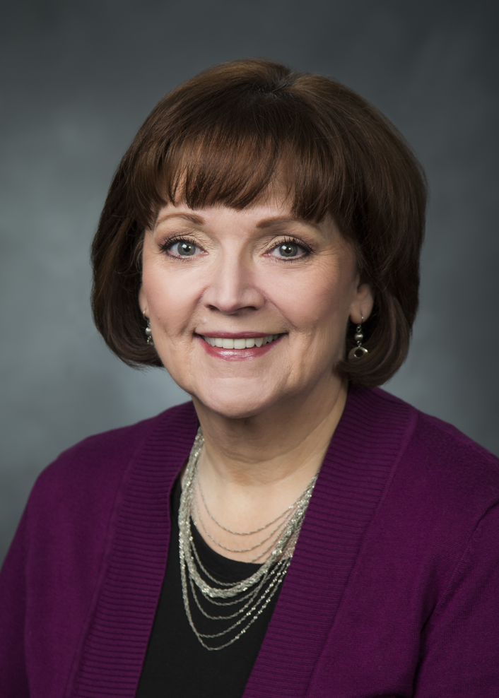
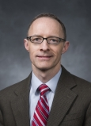
ADVOCATES
Lisa Leavitt, Ph.D.
University Sexual
Assault Survivor
Advocate
Scott Hosford, Ph.D.
Confidential Advisor
to Respondents

Slide 7

Must wait until the question is read in its entirety before raising your hand
  If you raise your hand, you must answer
Only the first team to raise their hand may answer. If they answer incorrectly, the answer will be given by the host
You do not lose points for answering incorrectly
Whoever answers correctly chooses the next question
  If no one answers correctly, the same team chooses the next question
Two Daily Doubles on the board
  Only the team who selected the daily double may answer
  Must decide how much to wager (minimum of 5 to a max of your entire score or 500, whichever is greater)
  Whether they answer correctly or not, that team maintains control of the board

Slide 8

Sexual Harassment Policy | Consent | Info for Victims/Respondents | Reporting Misconduct | TIX Process
100 | 100 | 100 | 100 | 100
200 | 200 | 200 | 200 | 200
300 | 300 | 300 | 300 | 300
400 | 400 | 400 | 400 | 400
500 | 500 | 500 | 500 | 500

Slide 9

Sexual Harassment -100
Which of the following does not fall under the umbrella of “sexual harassment”?
  Quid pro quo or hostile environment
  Sexual assault/sexual violence
  Domestic violence
  Mutual Flirtation
  Dating violence
  Stalking
Notes:
Mutual Flirtation

Slide 10

Sexual Harassment-200
Which of the following are protected by BYU’s Sexual Harassment Policy?
Students
Employees
Participants in university programs
Visitors to campus
All of the above
Notes:
All of the above

Slide 11
Sexual Harassment -300
Fill in the blank:
Sexual harassment is _____ conduct of a sexual nature.
unwelcome
Notes:
Examples:
Suggestive or offensive joking, flirting, or comments
Intentional touching
Verbal abuse
Comments about an individual’s body
Displaying objects or Reporting Misconduct
Sending explicit or offensive text messages or other communications

Slide 12
Sexual Harassment-400
Tyra has received multiple explicit direct messages via Instagram from a man she doesn’t know. Then, she saw him parked in a car next to hers in her apartment complex, and she feels scared. Is there anything to report?
Notes:
Stalking occurs when there is a course of conduct (typically two or more acts) directed at a specific person that makes the person fear for their safety, others’ safety, or causes
them to suffer emotional distress
Stalking can be physical or electronic

Slide 13
Sexual Harassment -500
True or False?
The BYU Sexual Harassment policy does not cover relations between married individuals.
False
Dating Violence, Domestic Violence, nonconsensual marital sexual activities, any form of sexual violence.
Notes:
Dating Violence, Domestic Violence, nonconsensual marital sexual activities, any form of sexual violence.
Sexual violence is any unwanted
sexual contact resulting from force, threats, bribes, manipulation, or
pressure
Examples of sexual violence include:
Rape
Nonconsensual oral sex
Sexual assault
Sexual abuse of a child

Slide 14
Consent -100
Fill in the blank:
Consent is a ________ agreement to engage in intimate activity.
voluntary
Notes:
Voluntary—need an affirmative yes

Slide 15
Consent -200
Tim asked Lyla if she wanted to hike Y mountain. She said “Sure!”, so off they went. At the second switchback, Lyla changed her mind, saying “Nah, I don’t want to do this anymore.”
Tim said “Well, we’ve already started, so now we have to finish!”
Notes:
No—consent can be withdrawn at any time.

Slide 16


Consent -300
Notes:
Only the contestant who selected the Daily Double clue may respond to that clue. Before the clue is revealed, the contestant must decide how much of their current score to wager, from a minimum of $5 to a maximum of their entire score (known as a "true Daily Double") or the highest clue value available in the round, whichever is greater.^{[8]} Whether or not the contestant gives a correct question for the Daily Double, the contestant maintains control of the board.^{[8]}

Slide 17
Consent -300answer
Lyla and Tim have hiked Y mountain lots of times. They do it a few times each week. Sometimes they don’t even plan it, they just meet up there and hike.
On Saturday, Lyla went to pick Tim up for a hike; but, he was asleep. Thinking back on the many times they’d gone hiking together, Lyla put him in her car, drove him to the trailhead, and pulled him up the mountain.
Notes:
No—person who is incapacitated cannot give consent.

Slide 18
Consent - 400
Tim and Lyla go hiking all the time. They’ve climbed lots of different mountains and canyons. Timp, Mt. Nebo, Squaw Peak, you name it.
When Tim picked Lyla up to go hike the Y for the first time, she hesitated. But, because they had gone on lots of other hikes, Tim assumed she would want to hike the Y as well, so he took her along.
Notes:
Consent to any sexual act or prior consensual activity between or with any party does not necessarily constitute consent to any other sexual act. Consent may be initially given but may be withdrawn through words or conduct at any time prior to or during sexual activity.

Slide 19
Consent - 500
Lyla and Tim decided to hike Y mountain at midnight. They got to the Y, enjoyed the view, had a good time, then went home.
The next morning, Lyla woke Tim up and said “Let’s go, we’re heading up to the Y again!” Tim was tired, and said he didn’t want to hike today.
“Well, you didn’t have a problem with it yesterday,” Lyla shrugged. “So here we go!”

Slide 20
Info for Victims/Respondents -100
True or False?
Campus resources are only available to victims if the offense occurred on campus.
False
Notes:
If you are a victim of dating violence, domestic violence, sexual assault, or stalking – whether the offenses occurred on or off campus – there are multiple resources available to you
1. Assess your physical safety
If you are not safe, call 9-1-1 immediately
When possible, preserve evidence
2. Remember that what happened to you was not your fault
Being a victim is never a violation of the Honor Code
3. Seek medical attention
Exams can be done at local emergency rooms or the Student Health Center
Exam costs are typically covered by the Utah Office for Victims of Crime

Slide 21
Info for Victims/Respondents -100
  BYU Title IX Office (1085 WSC, 801-422- 8692, t9coordinator@byu.edu)
  University Police (2120 JKB, 801-422-2222)
  BYU's Sexual Assault Survivor Advocate (1500 WSC, 801-422-9071)
  Provo Police Department (801-852-6210)
  Orem Police Department (801-229-7070)
If you would like to talk to someone right away, you can call any of the following for free, confidential counseling, 24 hours a day
  BYU Counseling and Psychological Services (801-422-2222)
  Center for Women and Children in Crisis (801-356-2511)
  Rape Recovery Center Crisis Line (801-467-7273)
  National Sexual Assault Hotline (1-800-656-4673)
Notes:
If you are a victim of dating violence, domestic violence, sexual assault, or stalking – whether the offenses occurred on or off campus – there are multiple resources available to you
1. Assess your physical safety
If you are not safe, call 9-1-1 immediately
When possible, preserve evidence
2. Remember that what happened to you was not your fault
Being a victim is never a violation of the Honor Code
3. Seek medical attention
Exams can be done at local emergency rooms or the Student Health Center
Exam costs are typically covered by the Utah Office for Victims of Crime

Slide 22
Info for Victims/Respondents -200
True or False?
Every report to the Title IX office must be followed by a formal investigation
False
All reports made to the Title IX Office are added to the confidential Title IX report log, as required by federal regulation
Notes:
Reports are simply informational until a Formal Complaint is filed
If the complainant chooses not to file a Formal Complaint, supportive measures are still available
Only a filed Formal Complaint will initiate a process that may result in discipline

Slide 23
Info for Victims/Respondents -300
  Report made, recorded by Title IX office
  Supportive measures/resources offered to complainant
  Complainant given option to file a formal complaint
  Formal complaint filed
  Respondent presumed innocent
  Notice of allegations sent to both parties
  Investigation begins
  Option for informal resolution expires
  Parties may have a support person (advisor) throughout process
  Determination of responsibility made
  If violation of university policy is found, may be subject to discipline/sanctions
Notes:
Find the error

Slide 24
Info for Victims/Respondents -400
Spot the problem:
Tami, a BYU student, recently had a baby. She has been coordinating with her professors to get her classwork done in addition to her parental responsibilities.
While conversing with a TA over this week’s assignment, the TA says in passing “I don’t know, I think it’s probably more important for you to be at home with that baby…”
Notes:
The university will not tolerate unlawful sex discrimination and will take immediate and appropriate steps to stop unlawful discrimination, prevent its recurrence, and address its effects
BYU also prohibits unlawful sex discrimination

Slide 25
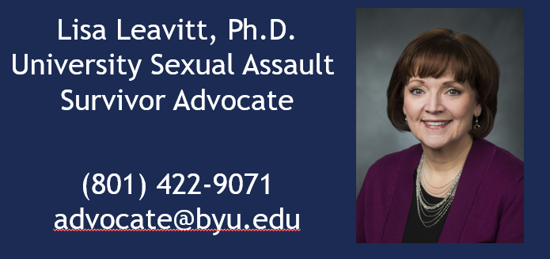
Info for Victims/Respondents -500
BYU offers a confidential advocate for victims.
Who is it?
Notes:
Lisa Leavitt

Slide 26
Reporting Misconduct -100
Which of the following are options for reporting sexual misconduct?
Title IX Coordinator
University Police
Local Police
School Administrators
Anonymous Reporting
Ethics Point
Notes:
All of the above

Slide 27
Reporting Misconduct -200
True or False?
Responsible employees have discretion whether to report incidents of sexual harassment?
False
Notes:
Responsible Employees should inform the reporting individual of their duty to report the incident to the Title IX Office
A dean, director, department chair, professor, coach, or any other university employee in a managerial, or supervisory role
who, while in that role, becomes aware of or reasonably suspects
any incidents of Sexual Harassment must promptly report all relevant
information to the Title IX Coordinator
A "responsible employee" who, while in that role, becomes aware of any incident of Sexual Misconduct is required to report it to the Title IX Coordinator.

Slide 28
Reporting Misconduct -300
True or False?
All employees who receive information regarding possible sexual misconduct are required to report it.
False
Certain privileged exceptions apply
Notes:
Individuals who receive information as a part of a confidential communication in the context of a professional or otherwise
privileged relationship are not required to make a report on that information to the Title IX Office
Doctor
Therapist
Lawyer
Ecclesiastical leader
Spouse

Slide 29
Reporting Misconduct -400
Notes:
Only the contestant who selected the Daily Double clue may respond to that clue. Before the clue is revealed, the contestant must decide how much of their current score to wager, from a minimum of $5 to a maximum of their entire score (known as a "true Daily Double") or the highest clue value available in the round, whichever is greater.^{[8]} Whether or not the contestant gives a correct question for the Daily Double, the contestant maintains control of the board.^{[8]}

Slide 30
Reporting Misconduct -400(Answer)
Which of the following behaviors are considered to be “sexual misconduct” at BYU?
  Sexual Harassment
  Sexual Assault
  Domestic and Dating Violence
  Stalking
  All of the above

Slide 31
Reporting Misconduct -500
How can reports of sexual harassment be made to
the Title IX office?
Online at titleix.byu.edu
Via email at t9coordinator@byu.edu
By phone at 801-422-8692
In person in 1085 Wilkinson Student Center

Slide 32
TIX Process -100
True or False:
The Title IX Office and the Honor Code office share information about victims.
False
Notes:
The Title IX Office will not share victim or witness information with the Honor Code Office

Slide 33
TIX Process - 200
Right or Wrong?
Landry went to a party on Saturday night at a friend’s house. Someone brought alcohol to the party, and Landry had a few drinks. Later at the party, he was sexually assaulted. Landry is afraid to report the assault, because he is afraid he’ll get kicked out of school for drinking.
Wrong
Amnesty & Leniency
Notes:
The Title IX Office keeps complainant and witness identifying information confidential
Amnesty is granted for Honor Code violations that arise out of the same facts or circumstances as the report
Leniency is granted for other Honor Code violations that may be found
Violations will generally be handled such that a student can stay in school
Those found in violation of the Sexual Harassment Policy are not entitled to confidentiality or amnesty
Confidentiality, amnesty, and leniency apply to investigations occurring under both the Title IX and Non-Title IX procedures

Slide 34
TIX Process -300
Right or Wrong?
Jess works on campus, and enjoys her job. However, her boss has made some inappropriate comments to her which make her uncomfortable. She’s afraid that if she reports the behavior, her boss will get mad and fire her, or give her all the worst tasks at work.
Wrong
Notes:
Retaliation and intimidation are strictly prohibited and should be promptly reported
The university will take steps to prevent retaliation and will take strong responsive action against acts of retaliation

Slide 35
TIX Process -400
Which of the following is not a supportive measure that can be offered by BYU?
  Preserving equal access to programs/activities
  Referral to the University Survivor Advocate or Respondent Advisor
  Police SafeWalk Services
  No Contact Orders
  Restraining Order
  Modifications of work/class schedules
Notes:
Protective orders, stalking injunctions, and similar orders may be obtained through the applicable court system

Slide 36
TIX Process -500
True or False:
Supportive measures can be taken/provided even if there is no investigation, or whether or not a victim chooses to report to University Police or local law enforcement.
True
Notes:
True

Slide 37
Final Jeopardy
Who is the Title IX Coordinator at BYU?
Tiffany Turley
Title IX Coordinator
Notes:
Volleyball
Track

Slide 38
PLEASE ADD THE TITLE IX OFFICE CONTACT INFORMATION TO YOUR PHONE
Title IX Office
Tiffany Turley
801-422-8692
t9coordinator@byu.edu
titleix.byu.edu
Respondent Advisor
Dr. Scott Hosford
2500 WSC
801-422-2723
scott_hosford@byu.edu
Victim Advocate
Dr. Lisa Leavitt
1500 WSC
801-422-9071
advocate@byu.edu
24-Hour Assistance
BYU Police 801-422-2222
Emergencies 911
Rape Crisis 801-467-7273
Suicide Prevention 1-800-273-8255

