Slide 1
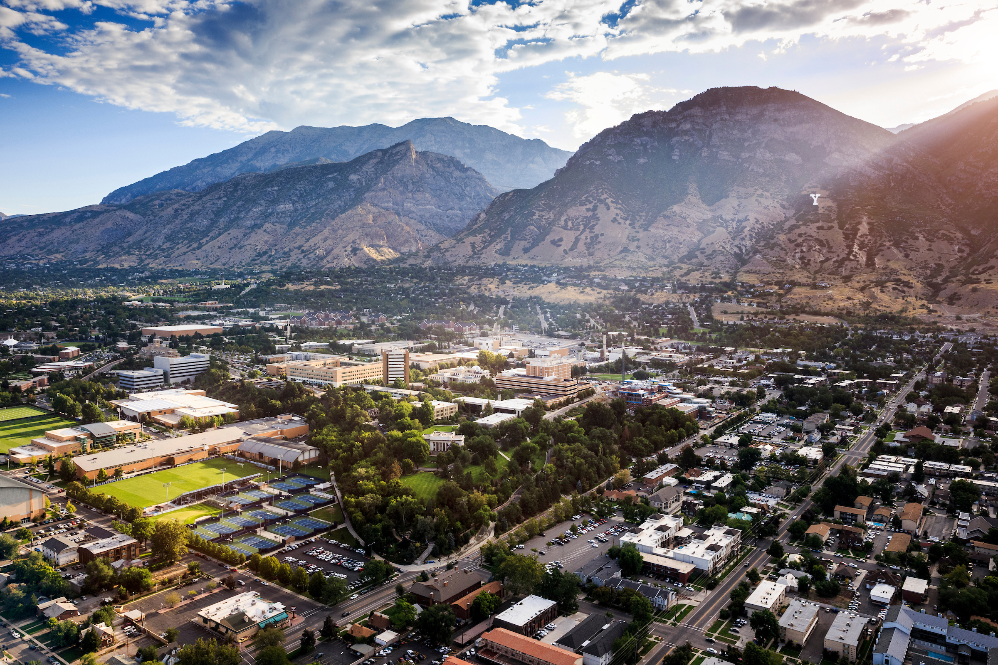

BYU TITLE IX
NON-LIVE HEARING
DECISION MAKER TRAINING

Slide 2

DECISION MAKER TRAINING
This training is being provided in accordance with BYU’s Sexual Harassment Policy and the 2020 amendments to the Code of Federal Regulations for Title IX
This training is being provided to Title IX decision makers who are designated by the university to make determinations regarding responsibility in sexual harassment cases
As required by policy and federal regulation, this training will be made available online

Slide 3
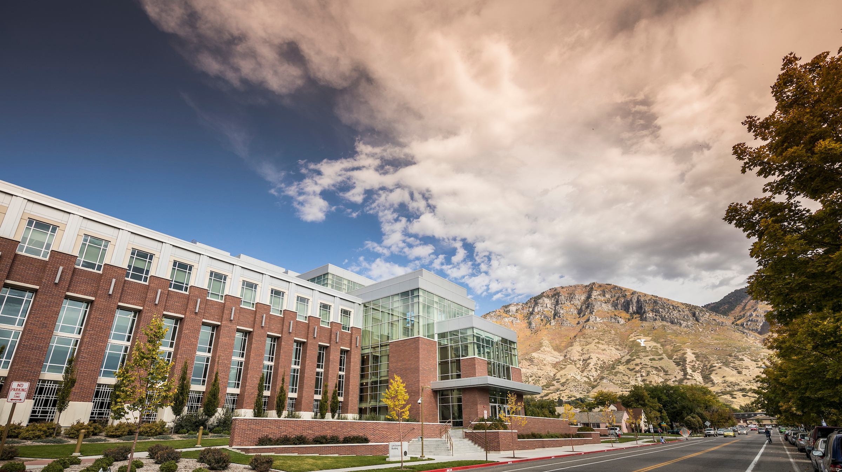
Brigham Young University is
committed to promoting and maintaining a safe and respectful environment for the campus community

Slide 4

BYU’S TITLE IX OFFICE
The Title IX Office is dedicated to promoting equitable treatment on the basis of sex by coordinating the university's efforts to prevent and respond to sex discrimination and sexual harassment

Slide 5

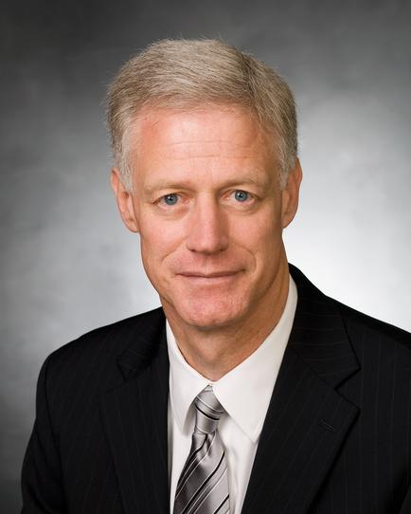
"Our top priority has always been the safety and well-being of our students… they are looking for our help and support. We have an obligation not only to provide that support, both emotionally and spiritually, but also to create an environment where sexual assault is eliminated."
BYU President Kevin J Worthen

Slide 6
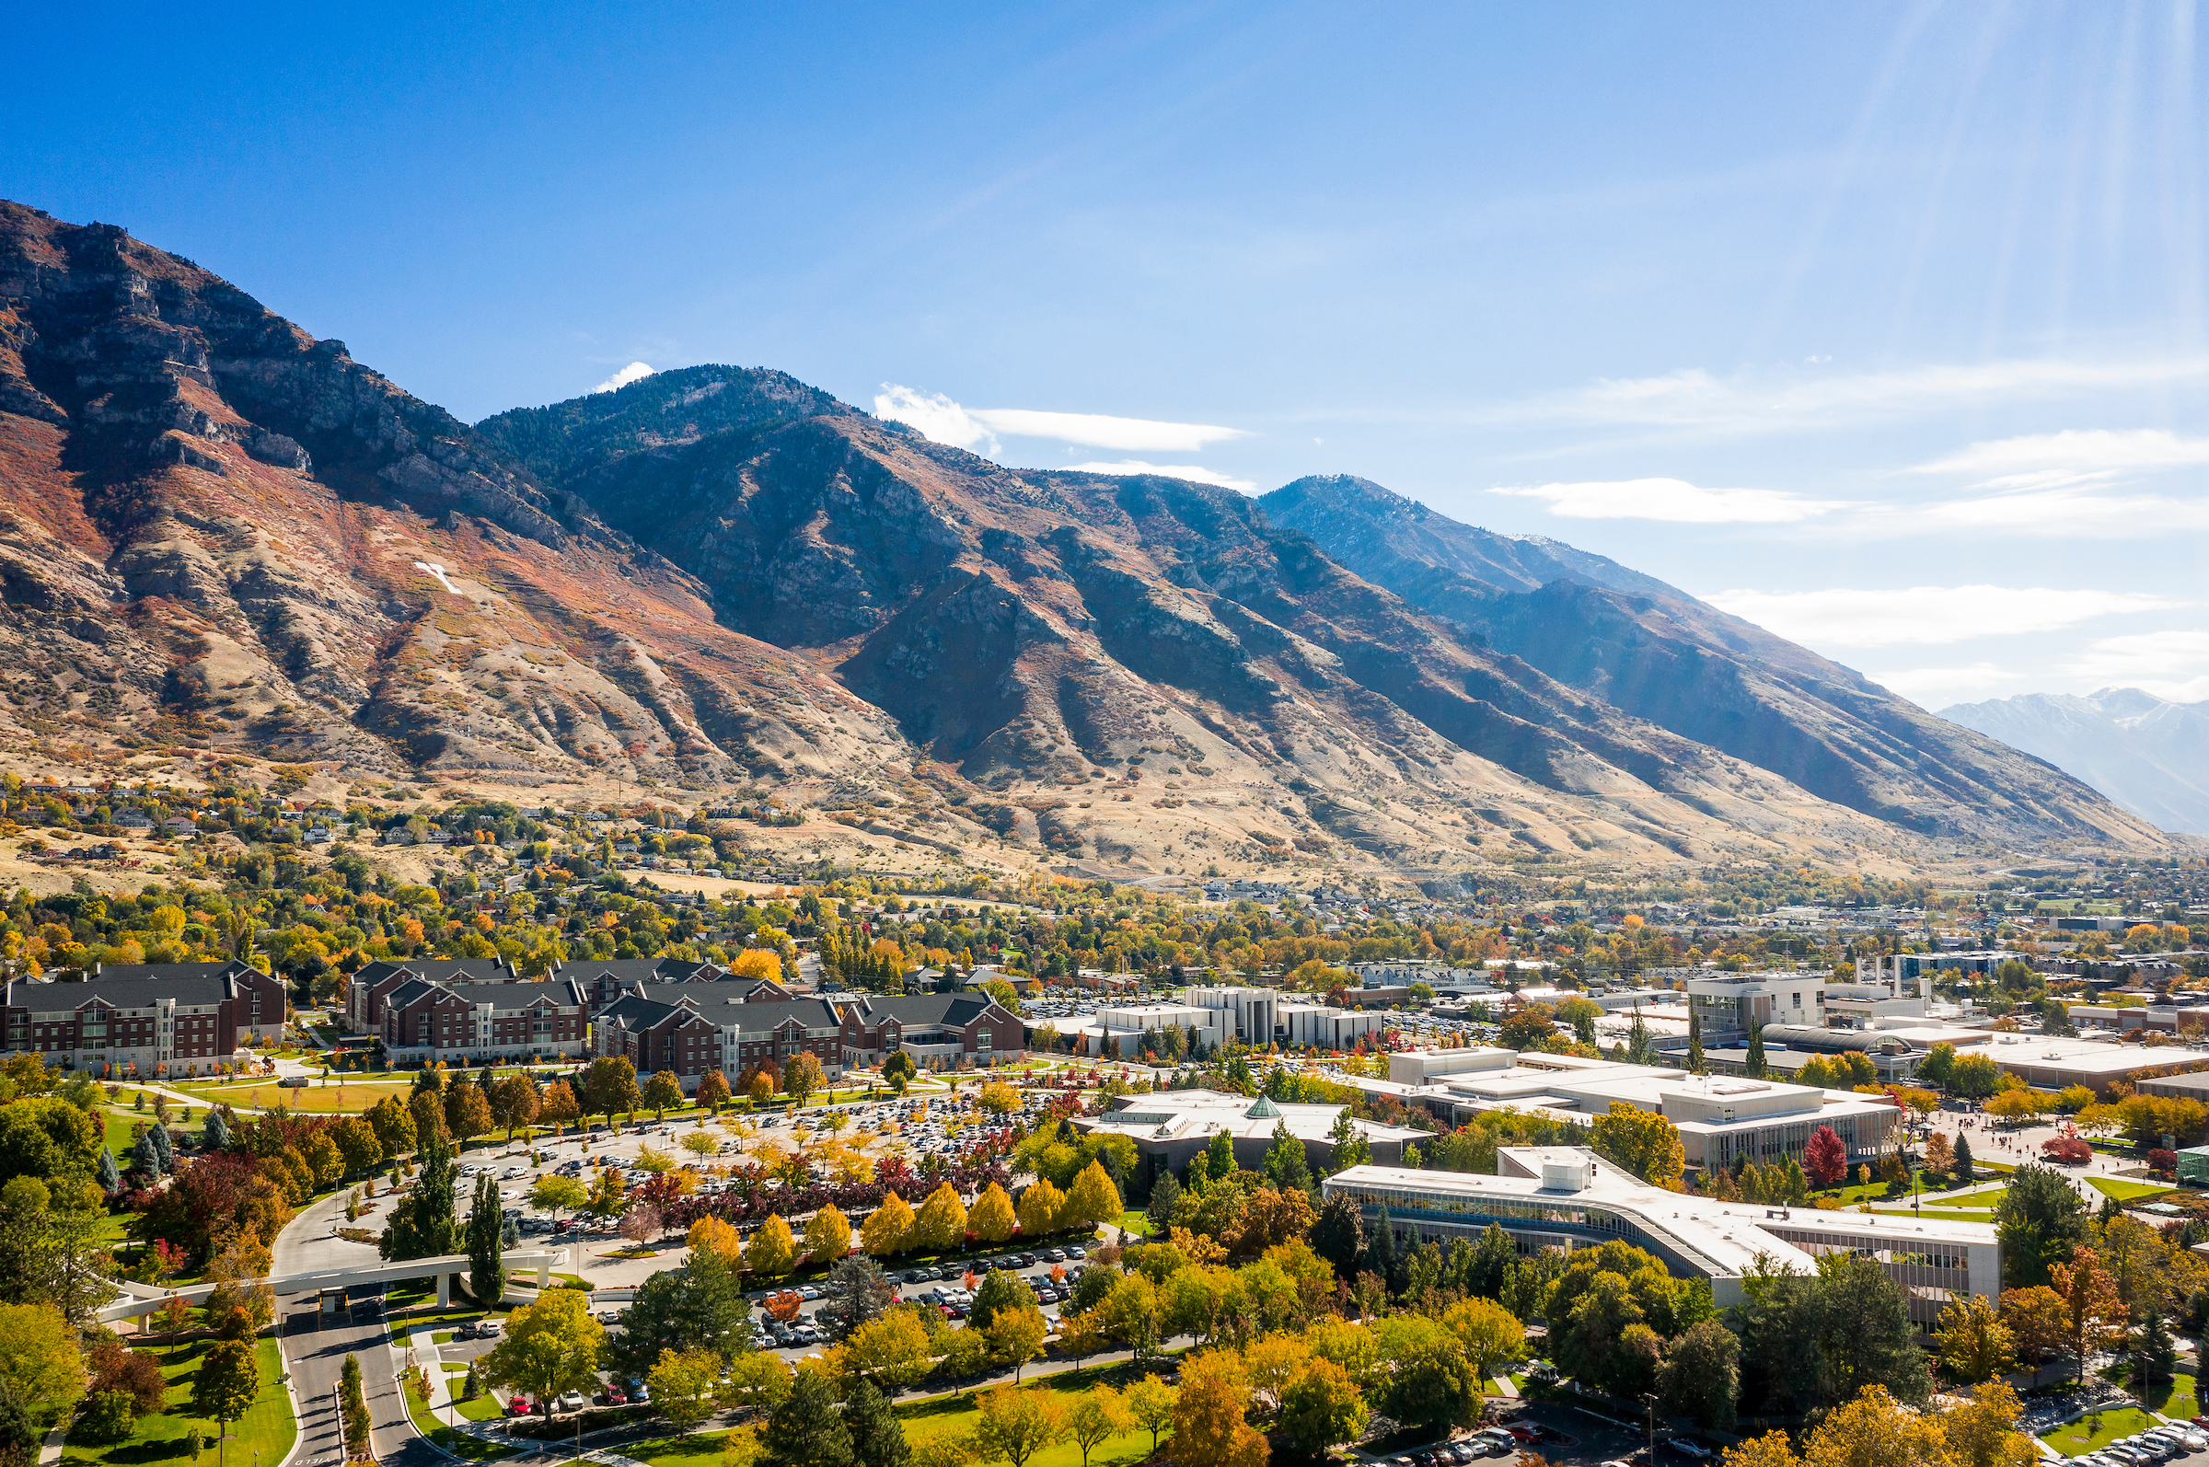
THE ROLE OF A TITLE IX
DECISION MAKER

Slide 7
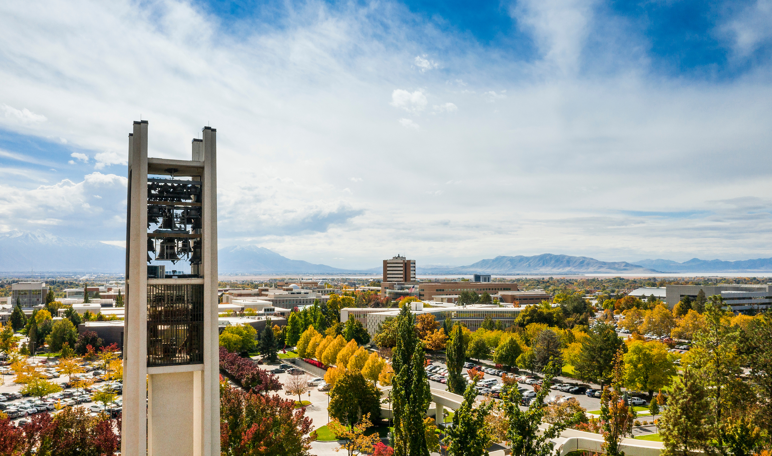
THE ROLE OF A
TITLE IX
DECISION MAKER
Review evidence and the investigative file prior to the panel meeting
Participate in the panel meeting as an unbiased evaluator of the evidence
Ask questions of the investigator as needed
Come to a determination, by majority vote, with the panel regarding responsibility

Slide 8

EXPECTATIONS OF DECISION MAKERS
Understand the policy and fully review the case file prior to the panel meeting
Actively engage and be attentive during the panel meeting
Treat all involved parties with respect and dignity
Evaluate the evidence in an unbiased way
Adhere to BYU’s policies and procedures
PREPARE
EVALUATE
BE PRESENT

Slide 9

THE DEFINITION OF SEXUAL HARASSMENT

Slide 10
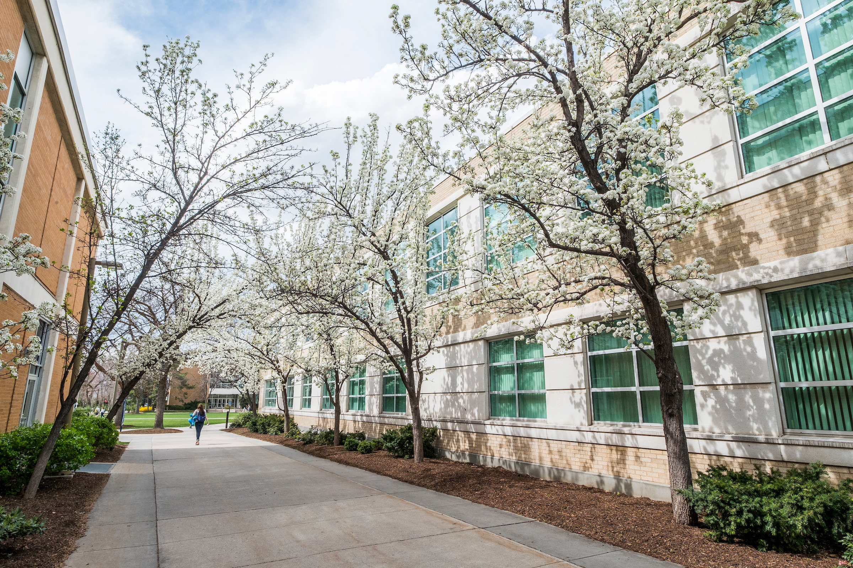
No person in the United States shall, on the basis of sex, be excluded from participation in, be denied the benefits of, or be subjected to discrimination under any education program or activity receiving Federal financial assistance.
Title IX of the Education Amendments of 1972

Slide 11


Sex Discrimination
Title IX
Sexual Harassment
Examples of Sex Discrimination:
Unequal pay or benefits
Disfavor in hiring or promotion
Inequitable support of teams, programs, or facilities
Consideration of sex in admissions & financial aid
“Traditional” Sexual Harassment:
Unwelcome conduct of a sexual nature
Benefits conditioned on sexual conduct (quid pro quo)
Sexual Violence:
Sexual Assault
Dating Violence
Domestic Violence
Stalking

Slide 12
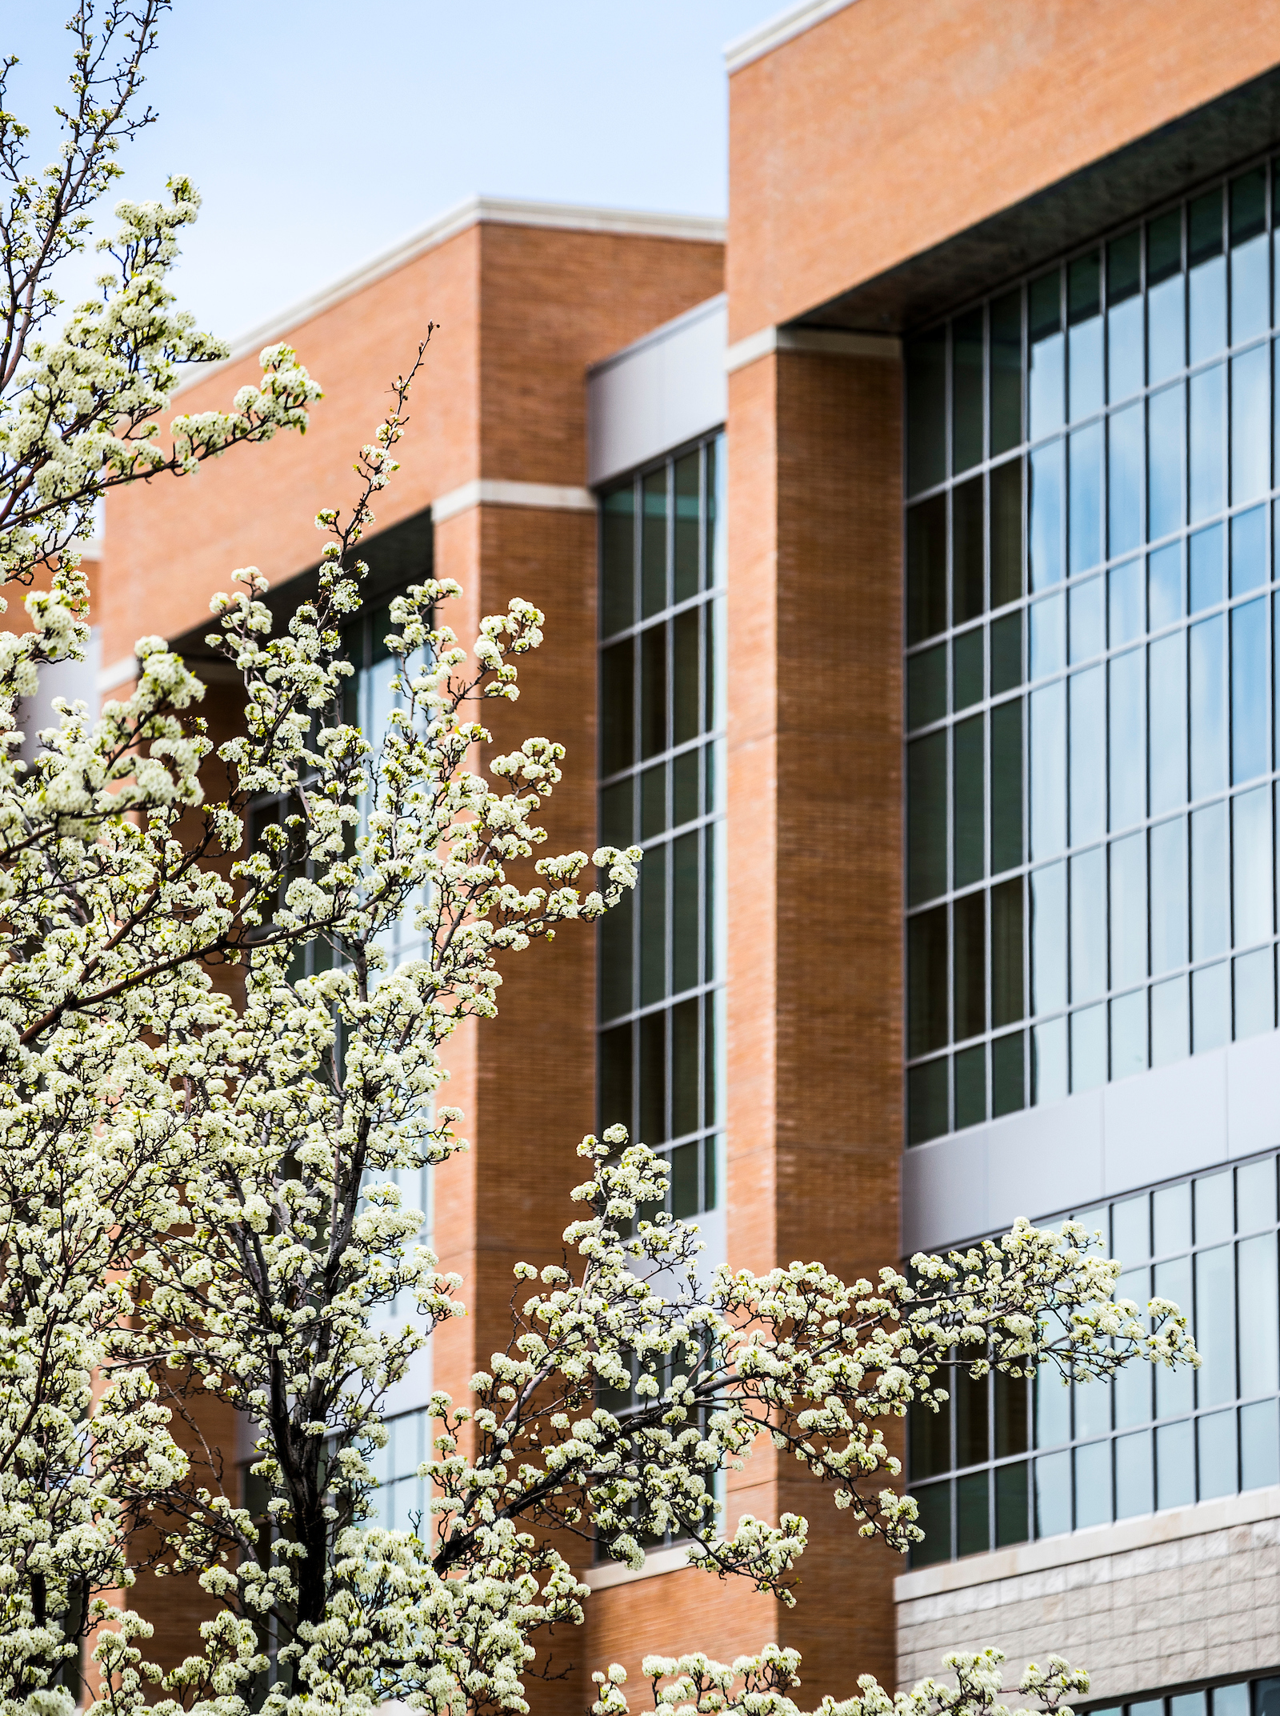
INVOLVED PARTIES
Complainant
An individual alleged to be the victim of sexual harassment
Respondent
An individual alleged to be responsible for sexual harassment

Slide 13
Sexual Harassment means conduct on the basis of sex
that satisfies one or more of the following:
BYU Sexual Harassment Policy (I. Definitions)
A BYU employee or faculty member conditions the provision of an aid, benefit, or service of BYU on an individual’s participation in unwelcome sexual conduct
Unwelcome conduct determined by a reasonable person to be so severe, pervasive, and objectively offensive that it effectively denies a person equal access to BYU’s Education Program or Activity
Sexual Assault,
Dating Violence,
Domestic Violence, or
Stalking

Slide 14
Sexual Assault means any sexual act directed against a Complainant without the Complainant’s Consent. Sexual Assault includes fondling, incest, rape, sexual assault with an object, sodomy, and statutory rape.
Dating Violence means violence committed by a person who is or has been in a social relationship of a romantic or intimate nature with the Complainant. The existence of such a relationship will be determined based on a consideration of the following factors: the length of the relationship, the type of relationship, and the frequency of interaction between the persons involved in the relationship.
Domestic Violence means a violent act committed by a current or former spouse or intimate partner of the Complainant, by a person with whom the Complainant shares a child in common, by a person similarly situated to a spouse of the Complainant, or by any other person against a victim who is protected from that person’s acts under state domestic or family violence laws.
Stalking means engaging in a course of conduct (two or more acts) directed at a specific person that would cause a reasonable person to fear for his or her safety or the safety of others, or to suffer substantial emotional distress. Both in-person and electronic stalking are prohibited.

Slide 15
THE SCOPE OF BYU’S EDUCATION PROGRAMMING AND ACTIVITIES

Slide 16
Education Program or Activity means all of a school’s operations, and BYU’s Education Program or Activity includes all locations, events, or circumstances over which the university exercised substantial control over both the Respondent and the context in which the Sexual Harassment occurred.
BYU Sexual Harassment Policy (I. Definitions)

Slide 17

Behavior that occurred in the United States as part of a school’s education program or activity
Typically, BYU campus or campus-owned property…
Where the respondent (alleged perpetrator) is affiliated with BYU…
And the incident happened in a situation where
BYU had substantial control

Slide 18

EXAMPLES OF BYU EDUCATION
PROGRAM OR ACTIVITIES
Admissions
Academic instruction (classes)
Workplace
Hiring
On-campus housing
Athletic teams
Art performances
Sponsored club activities
The following are generally NOT considered part of BYU’s education program or activities:
Off-campus housing, social media, ward and church activities

Slide 19
INVESTIGATIONS AND THE GRIEVANCE PROCESS

Slide 20

INVESTIGATIONS
Both the complainant and the respondent are treated equitably, and the respondent is presumed innocent until proven otherwise
Statements and evidence may be submitted by both parties
All can have a support person with them during interviews and other meetings during the investigation process
The evidentiary standard used during investigations is a preponderance of the evidence (more likely than not)
Determinations of responsibility are not made until the conclusion of the investigative process, which is typically 60 days

Slide 21
GRIEVANCE PROCEDURES
BYU utilizes two primary grievance procedures (Title IX and Non-Title IX) to respond to sexual harassment, depending on the circumstances of the allegations
If the alleged incident(s) of sexual harassment occurred 1) against a person in the United States who 2) is participating in or attempting to participate in a university program or activity, the Title IX grievance procedures will be followed
If a claim of sexual violence is alleged against a BYU employee or student, but the alleged incident(s) did not occur in the United States or did not occur in a university education program or activity, the Non-Title IX grievance procedures will be followed
Formal Complaints that do not fall in either of these categories will be evaluated to determine which university procedures to follow

Slide 22
TITLE IX
NON-TITLE IX
Initiated by a Formal Complaint
Option to resolve with an informal resolution (unless harassment is employee on student)
Investigations (information gathering) done by trained personnel in the Title IX Office
Parties may submit written response to Investigative Report
Decision makers review written record and conduct a live hearing with witnesses, questioning, and cross examination
Panel of Decision Makers provides written determination of responsibility.
Initiated by a Formal Complaint
Option to resolve with an informal resolution
(unless harassment is employee on student)
Investigations (information gathering) done by trained personnel in the Title IX Office
Parties may submit written response to Preliminary Investigative Report
Decision makers review written record and may question investigator (no live hearing)
Panel of Decision Makers provides written determination of responsibility.

Slide 23
DETERMINATIONS REGARDING RESPONSIBILITY
Title IX Decision Makers
Students | Associate Dean of Students Director of CAPS Title IX designee
Student employees (if allegations occurred in employment setting) | Associate Dean of Students Director of CAPS Title IX designee Immediate supervisor ER managing director
Faculty | Academic vice president Dean or immediate supervisor Title IX designee
Administrative/staff employees | Responsible vice president ER managing director Title IX designee
Athletic professionals | Advancement vice president Faculty Relations manager Title IX designee
Non-student and non-employee | Banning officer Vice president over the program
Non-Title IX Decision Makers
Students | Associate Dean of Students Director of CAPS Title IX designee
Student employees (if allegations occurred in employment setting) | Associate Dean of Students Director of CAPS Title IX designee Immediate supervisor ER managing director
Faculty | Academic vice president Dean or immediate supervisor Title IX designee
Administrative/staff employees | Responsible vice president ER managing director Title IX designee
Athletic professionals | Advancement vice president Faculty Relations manager Title IX designee
All individuals involved in administering Sexual Harassment grievance procedures will receive applicable training within the past twelve months.

Slide 24
DETERMINATIONS REGARDING RESPONSIBILITY
Determinations regarding responsibility of the allegations must be made by majority vote
Either party unsatisfied with the determination/decision may appeal as outlined in policy
The written determination will be issued within 60 days of the panel meeting

Slide 25
ADDITIONAL POINTS
Determinations regarding responsibility are not intended to evaluate right and wrong, but rather to decide whether or not there has been a violation of the university’s Sexual Misconduct Policy, proven by the designated preponderance of the evidence standard
Decisions must be impartial and fair (both the finding and the sanction) and directly related to and based upon the evidence

Slide 26
TITLE IX PANEL MEETINGS

Slide 27
PREPARING FOR THE PANEL MEETING
Review the Sexual Harassment Policy and corresponding Sexual Harassment Grievance Procedures (Non-Title IX Sexual Violence)
Review the investigative file, final investigatory report, and any other provided investigation materials
Prepare any questions you would like to ask the investigator, if needed

Slide 28
PURPOSE OF THE PANEL MEETING
The purpose of the panel meeting is to help the decision makers evaluate and consider evidence on the following questions:
Does a preponderance of the evidence show (is it more likely than not) that the prohibited conduct occurred as alleged?
If so, does that conduct constitute a violation of BYU’s Sexual Harassment Policy?
If the policy was violated, what is the appropriate remedy to restore or preserve equal access to BYU’s Education Program or Activity?

Slide 29

SERVING IMPARTIALLY
IN THE TITLE IX PROCESS

Slide 30
Everyone involved in a Title IX hearing must support an objective evaluation of the evidence
Objectivity includes the absence of any personal or professional interest that affects your ability to be fair and impartial to all parties in the proceeding and that actually affects the outcome of the proceeding
All decision makers should ensure they do not have a conflict of interest prior to participating in the live hearing (which may include a family, business, or personal relationship with any of the parties, witnesses, investigators, etc.)

Slide 31

Beyond conflicts of interest, a Title IX decision maker must
approach the role impartially and without any prejudgment
Decision makers must set aside impressions or biases they may have from the media, other cases in which they may have been involved, and personal opinions
Title IX decision makers should act in the best interest of upholding the integrity of a fair and equitable process, not in pursuit of their own agenda

Slide 32
DECISION MAKERS
DO NOT…
DECISION MAKERS DO…
Rely on sex stereotypes
Make credibility determinations based on the sex or gender of a party or witness
Make credibility determinations based on a person’s role as Complainant or Respondent
Approach the investigation and live hearing with an open mind and without any preconceived notions
Consider participation in the process as an objective review of the facts and circumstances
Treat all parties, witnesses, and other involved administrators with respect

Slide 33
ADDITIONAL QUESTIONS AND ANSWERS

Slide 34
AS A DECISION MAKER, AM I RESPONSIBLE FOR ANY OF THE INVESTIGATION?
No. Investigative duties are performed by qualified investigators from the university’s Title IX Office. The results of the investigation will be provided to you, the parties, and the parties’ advisors prior to the live hearing.

Slide 35
CAN I TALK TO OTHERS
ABOUT THE CASE?
Parties to the investigation of a Formal Complaint are not restricted from discussing the allegations under investigation, especially as necessary to gather and present relevant evidence. But, given the sensitive nature of Sexual Harassment allegations, all participants in the grievance process, including decision makers, are requested to keep the allegations and investigation proceedings as confidential as possible. Decision makers must maintain the confidentiality of all information shared during the proceedings, must use this information only for purposes of these procedures, and must not further distribute or disclose this information.

Slide 36

IS THIS A LEGAL PROCEEDING?
No. Title IX investigations and decisions as discussed in this training are NOT civil or criminal legal proceedings. They are internal investigative processes and have only internal administrative repercussions.
You will be making decisions only on matters related to a BYU policy violation, not external laws.

Slide 37
WHAT HELP AND RESOURCES WILL I HAVE?
In addition to this training, you will have access to BYU policies, procedures, and materials relevant to the case in which you are involved. Should you need clarification or have process questions, you can consult with BYU’s Title IX Coordinator or BYU’s Office of General Counsel.

Slide 38
CONCLUSION

Slide 39
THINGS TO REMEMBER
BYU is committed to promoting a safe and respectful campus environment
BYU prohibits sexual harassment, which includes quid pro quo, hostile environment, and sexual violence (sexual assault, dating violence, domestic violence, and stalking)
The non-Title IX grievance procedures apply only to behavior that allegedly did NOT occur as part of BYU’s education programming and activities
The purpose of the panel meeting is to determine if there was a policy violation, and if so, what the appropriate remedy is
The role of decision makers is to prepare for the panel meeting and objectively evaluate the evidence in order to come to a determination regarding responsibility
Decision makers must participate impartially, not have any conflicts of interest, and conduct themselves with appropriate decorum

Slide 40
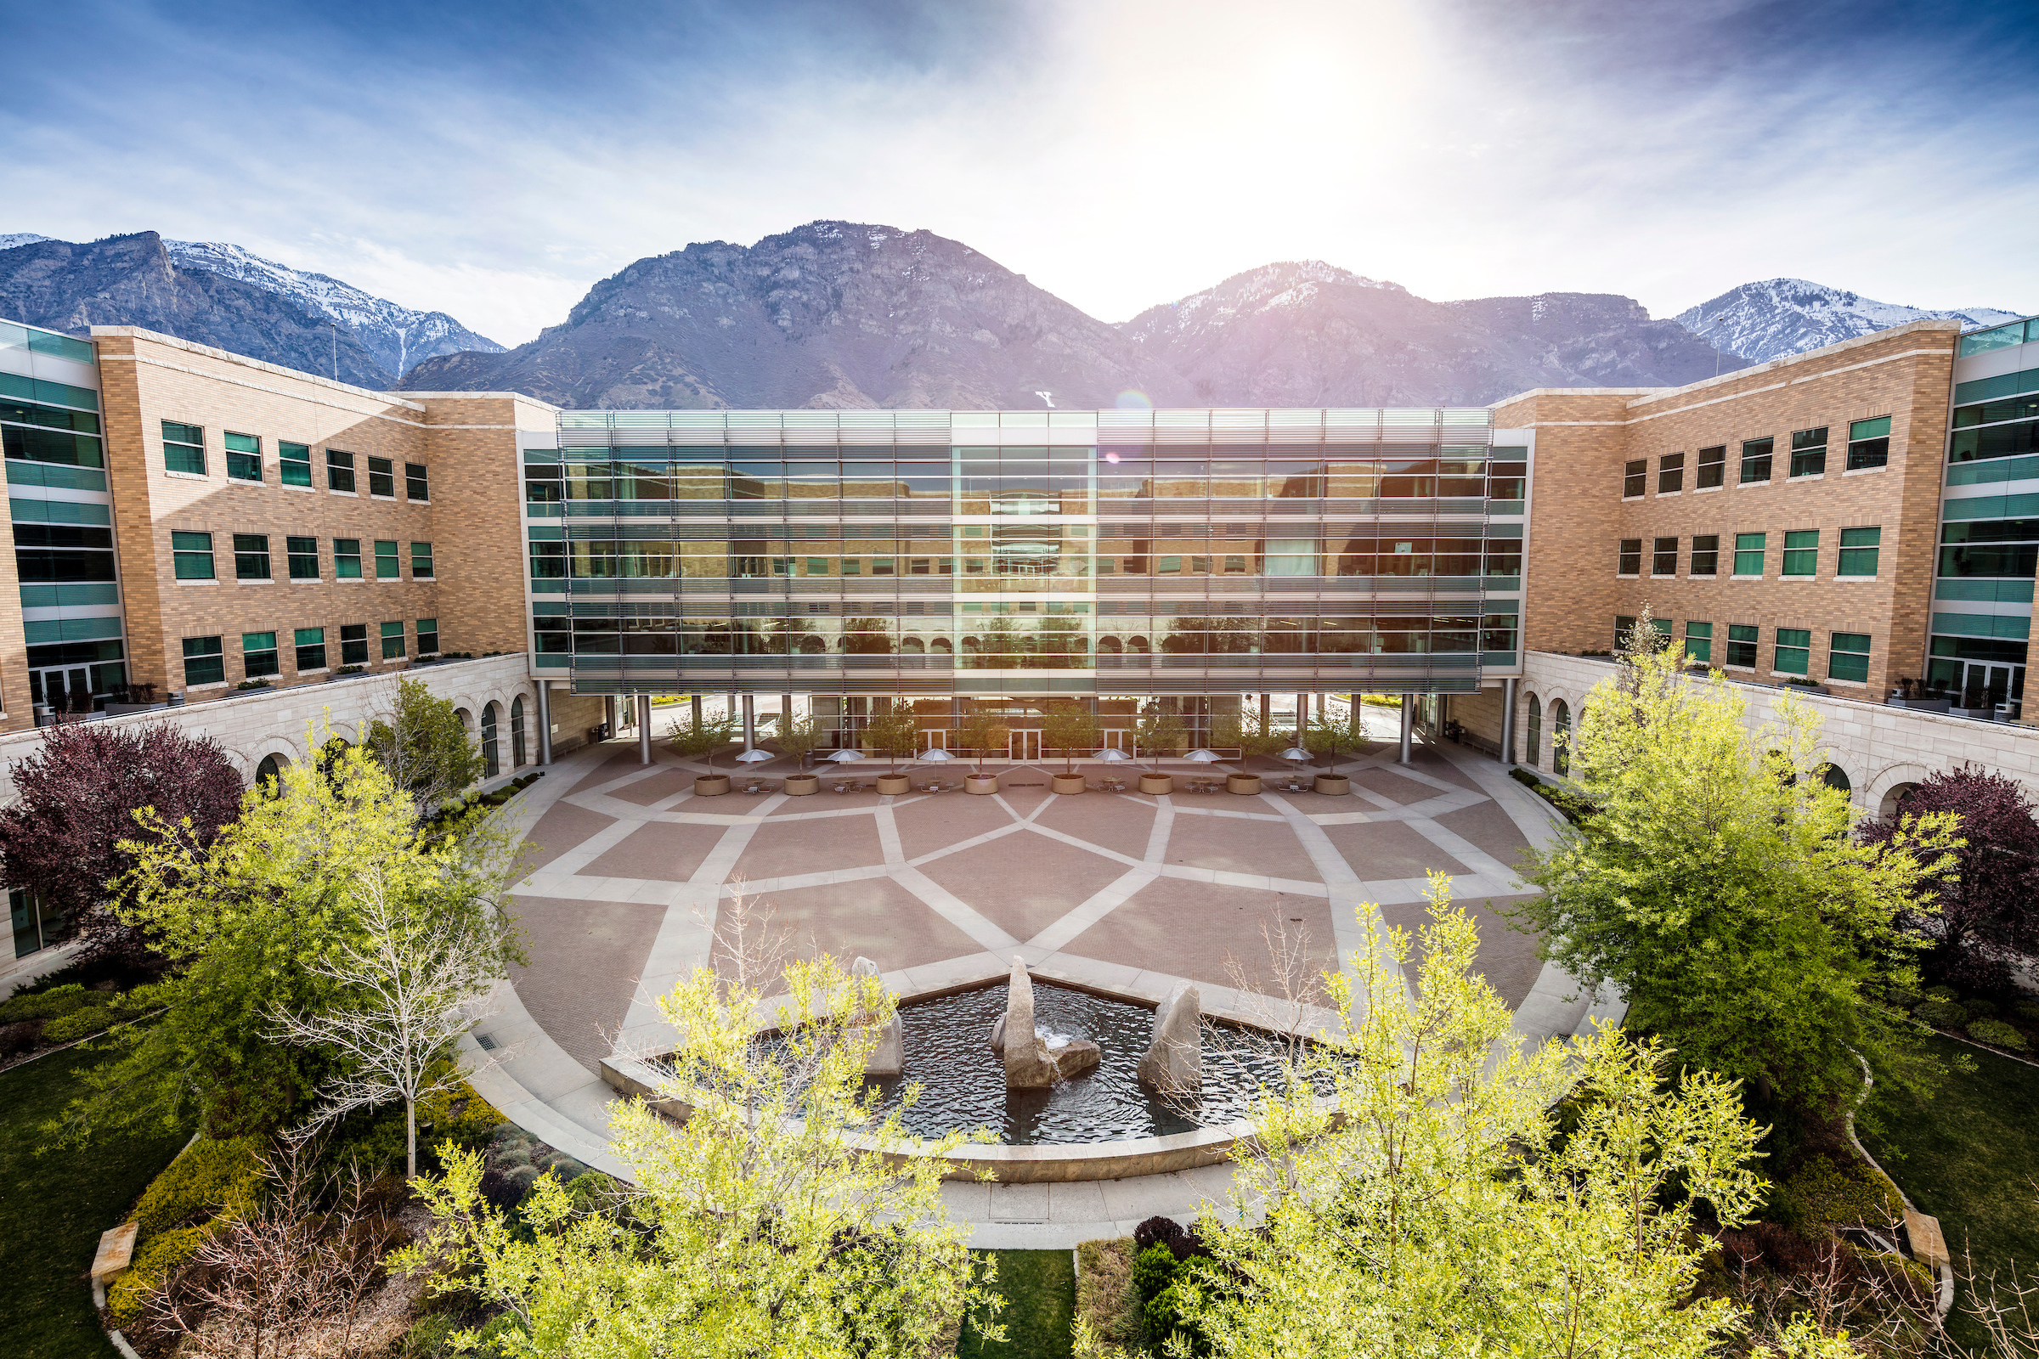
QUESTIONS?
Tiffany Turley
Title IX Coordinator
tiffany_turley@byu.edu
(801) 422-8692
Erik Davis
University Counsel
erik_davis@byu.edu
(801) 422-5941

